Slide 1
Welcome To The CJA Library!
2021-2022 School Year

Slide 2
CJA Library Media Center
Big Ideas
The library is a place that promotes a love of reading and supports students in their personal reading needs. The library is a place where students can acquire knowledge and gain insight.

Slide 3
Destiny Discover has everything!

Slide 4
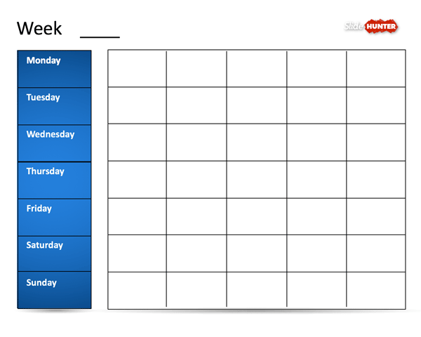
Students will visit the library weekly.
Samplee
Kg 3rd grade 1st grade 5th grade 2nd grade
Kg 3rd grade 1st grade 5th grade 4th grade
Library

Slide 5
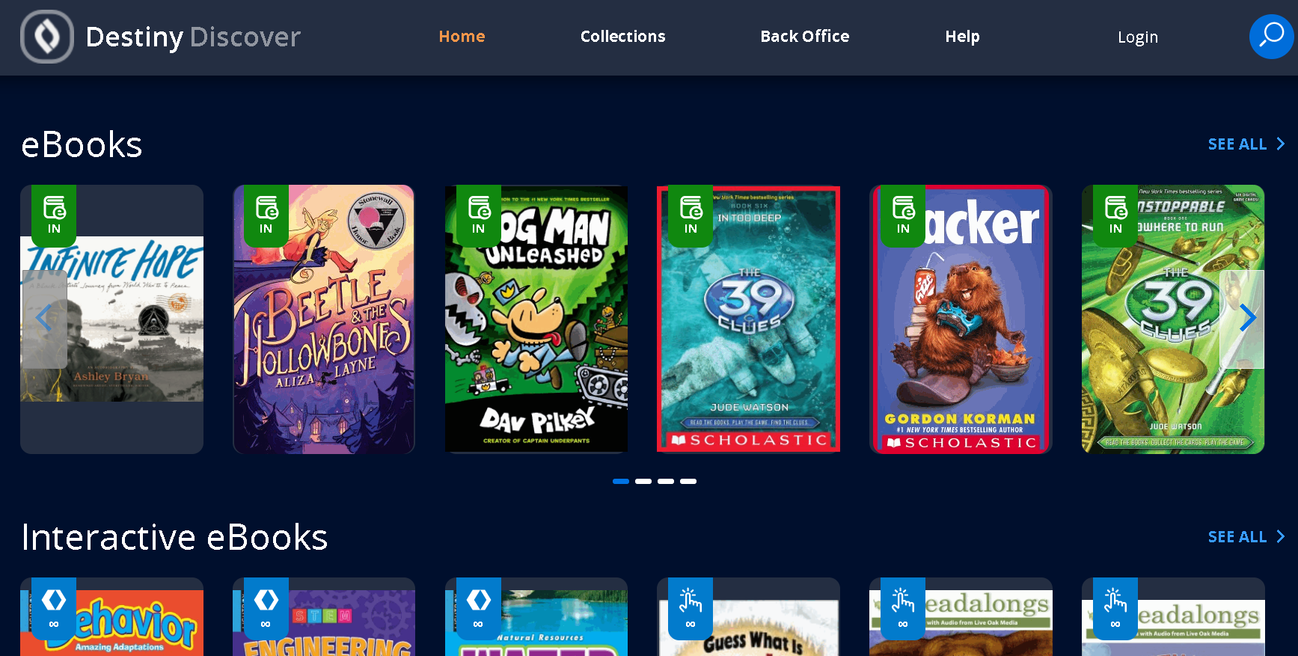
Students also have access to the Destiny Discover Library at home.
Destiny Discover access click here
Choose CJA
Log in with your student ID#
Password is follett

Slide 6
There is a great selection of books and eBooks I carefully selected for our student population. (A few examples)

Slide 7
The SLPS District selects eBooks and adds the books to our library collection also.

Slide 8
No matter where we are the library is always available!
CJA Library
Open 24 hours!
“The only thing that you absolutely have to know is the location of the library.” Albert Einstein

